Slide 1
Operating System
Tim Pengampu MK Sistem Operasi
Universitas Dian Nuswantoro

Slide 2
Virtualization
Virtualization is creation of an alternative to actual version of something:
virtual memory (more memory than physically available),
virtual time (buffering provides virtual/effective download time that less than the actual time),
Virtual hardware, desktop, disk, appliances, scenes,
Virtual worlds
In our context it is realizing one or more complete computer systems as guests on the base machine/operating system.
This offers an excellent conduit for delivering the vastly underutilized power of the multi-core and other resources such as storage and devices.

Slide 3
Operating System Environments
Virtual machines (VMs)
Software abstraction of a computer
Often executes on top of native operating system
Virtual machine operating system
Manages resources provided by virtual machine
Applications of virtual machines
Allow multiple instances of an operating system to execute concurrently
Emulation
Software or hardware mimics functionality of hardware or software not present in system
Promote portability

Slide 4
Overview
Fundamental idea – abstract hardware of a single computer into several different execution environments
Similar to layered approach
But layer creates virtual system (virtual machine, or VM) on which operation systems or applications can run
Several components
Host – underlying hardware system
Virtual machine manager (VMM) or hypervisor – creates and runs virtual machines by providing interface that is identical to the host
(Except in the case of paravirtualization)
Guest – process provided with virtual copy of the host
Usually an operating system
Single physical machine can run multiple operating systems concurrently, each in its own virtual machine

Slide 5
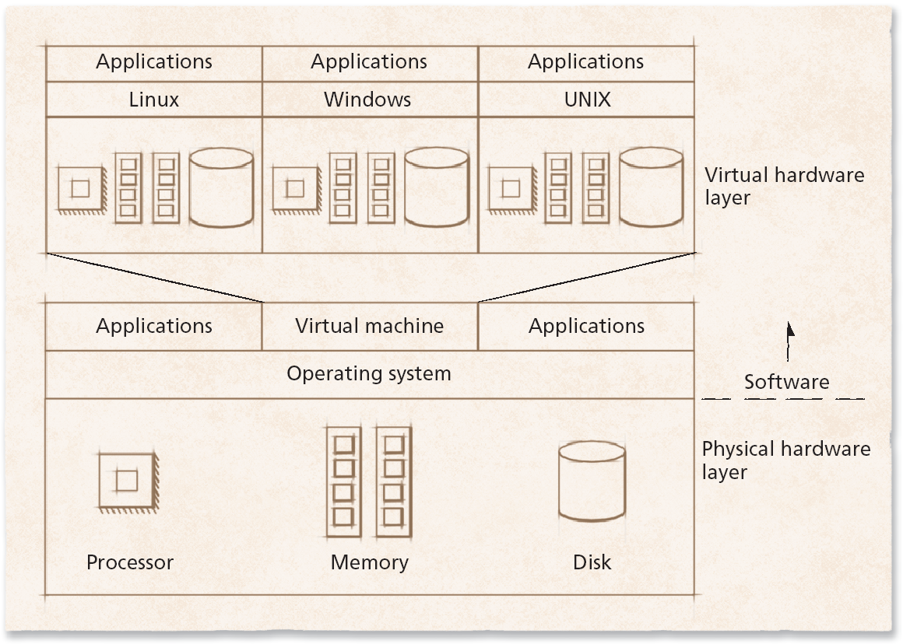
Schematic of a virtual machine

Slide 6
Virtualization (cont.)
Allows operating systems to run applications within other OSes
Vast and growing industry
Emulation used when source CPU type different from target type (i.e. PowerPC to Intel x86)
Generally slowest method
When computer language not compiled to native code – Interpretation
Virtualization – OS natively compiled for CPU, running guest OSes also natively compiled
Consider VMware running WinXP guests, each running applications, all on native WinXP host OS
VMM (virtual machine Manager) provides virtualization services

Slide 7
Virtualization (cont.)
Use cases involve laptops and desktops running multiple OSes for exploration or compatibility
Apple laptop running Mac OS X host, Windows as a guest
Developing apps for multiple OSes without having multiple systems
QA testing applications without having multiple systems
Executing and managing compute environments within data centers
VMM can run natively, in which case they are also the host
There is no general purpose host then (VMware ESX and Citrix XenServer)

Slide 8
Computing Environments - Virtualization

Slide 9
Implementation of VMMs
Other variations than “Full Virtualization” include:
Paravirtualization - Technique in which the guest operating system is modified to work in cooperation with the VMM to optimize performance
Programming-environment virtualization - VMMs do not virtualize real hardware but instead create an optimized virtual system
Used by Oracle Java and Microsoft.Net
Emulators – Allow applications written for one hardware environment to run on a very different hardware environment, such as a different type of CPU
Application containment - Not virtualization at all but rather provides virtualization-like features by segregating applications from the operating system, making them more secure, manageable
Including Oracle Solaris Zones, BSD Jails, and IBM AIX WPARs
Much variation due to breadth, depth and importance of virtualization in modern computing

Slide 10
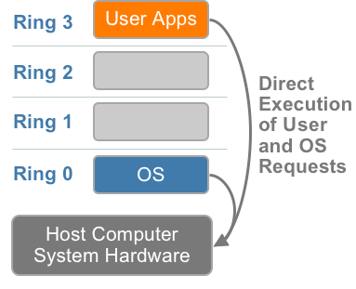
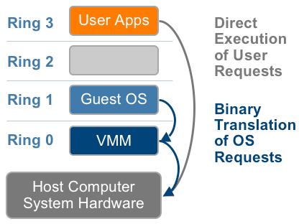
Full Virtualization
User level codes are executed directly on the processor
Translate kernel code to replace non-virtualizable instructions with new sequences of instructions that have the intended effects on the virtual hardware.
X86 privileged level arch w/o virtualization
Binary translation

Slide 11
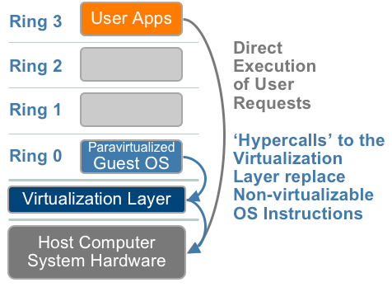
Types of VMs – Paravirtualization (OS-Assisted)
Modify the OS kernel to replace non-virtualizable instructions with hypercalls that comm directly with the virtualization layer hypervisor
Hypervisor also provides hypercall interfaces for other critical kernel ops such as mem management, interrupt handling and time keeping

Slide 12
Types of VMs – Paravirtualization (cont.)
Does not fit the definition of virtualization – VMM not presenting an exact duplication of underlying hardware
But still useful!
VMM provides services that guest must be modified to use
Leads to increased performance
Less needed as hardware support for VMs grows
Xen, leader in paravirtualized space, adds several techniques
For example, clean and simple device abstractions
Efficient I/O
Good communication between guest and VMM about device I/O
Each device has circular buffer shared by guest and VMM via shared memory

Slide 13
Types of VMs – Paravirtualization (cont.)
Xen, leader in paravirtualized space, adds several techniques (Cont.)
Memory management does not include nested page tables
Each guest has own read-only tables
Guest uses hypercall (call to hypervisor) when page-table changes needed
Paravirtualization allowed virtualization of older x86 CPUs (and others) without binary translation
Guest had to be modified to use run on paravirtualized VMM
But on modern CPUs Xen no longer requires guest modification -> no longer paravirtualization

Slide 14
Types of VMs – Emulation
Another (older) way for running one operating system on a different operating system
Virtualization requires underlying CPU to be same as guest was compiled for
Emulation allows guest to run on different CPU
Necessary to translate all guest instructions from guest CPU to native CPU
Emulation, not virtualization
Useful when host system has one architecture, guest compiled for other architecture
Company replacing outdated servers with new servers containing different CPU architecture, but still want to run old applications
Performance challenge – order of magnitude slower than native code
New machines faster than older machines so can reduce slowdown
Very popular – especially in gaming where old consoles emulated on new

Slide 15
Types of VMs – Programming Environment Virtualization
Also not-really-virtualization but using same techniques, providing similar features
Programming language is designed to run within custom-built virtualized environment
For example Oracle Java has many features that depend on running in Java Virtual Machine (JVM)
In this case virtualization is defined as providing APIs that define a set of features made available to a language and programs written in that language to provide an improved execution environment
JVM compiled to run on many systems (including some smart phones even)
Programs written in Java run in the JVM no matter the underlying system
Similar to interpreted languages

Slide 16
Types of VMs – Application Containment
Some goals of virtualization are segregation of apps, performance and resource management, easy start, stop, move, and management of them
Can do those things without full-fledged virtualization
If applications compiled for the host operating system, don’t need full virtualization to meet these goals
Oracle containers / zones for example create virtual layer between OS and apps
Only one kernel running – host OS
OS and devices are virtualized, providing resources within zone with impression that they are only processes on system
Each zone has its own applications; networking stack, addresses, and ports; user accounts, etc
CPU and memory resources divided between zones
Zone can have its own scheduler to use those resources

Slide 17
Benefits and Features
Host system protected from VMs, VMs protected from each other
I.e. A virus less likely to spread
Sharing is provided though via shared file system volume, network communication
Freeze, suspend, running VM
Then can move or copy somewhere else and resume
Snapshot of a given state, able to restore back to that state
Some VMMs allow multiple snapshots per VM
Clone by creating copy and running both original and copy
Great for OS research, better system development efficiency
Run multiple, different OSes on a single machine
Consolidation, app dev, …

Slide 18
Benefits and Features (cont.)
Templating – create an OS + application VM, provide it to customers, use it to create multiple instances of that combination
Live migration – move a running VM from one host to another!
No interruption of user access
All those features taken together -> cloud computing
Using APIs, programs tell cloud infrastructure (servers, networking, storage) to create new guests, VMs, virtual desktops

Slide 19
HostOS/GuestOS Products
VMware server: introductory package for small environments: limited use in large environments
Sun(now Oracle) xVM or Virtual Box: favorite among academicians. Adjustable video memory, remote device connectivity, RDP connectivity, snappy performance, may be best hosted virtualization package.

Slide 20

Any Question ?
Anything to discuss ?

